Slide 1



Git, GitHub & Maven
Distributed version control system

Slide 2
Git Overview
In this session, you will learn:
Distributed Version Control basics
Basic Git commands
Core concepts of Git like:
Creating new features without affecting the current working version (Branching)
Collaborating with other developers (clone, push, rebase and merge conflicts)
Saving new changes temporarily (Stashing)
Selecting particular changes from others
By the end of this session, you will be able to use Git.
Let’s get started!

Slide 3
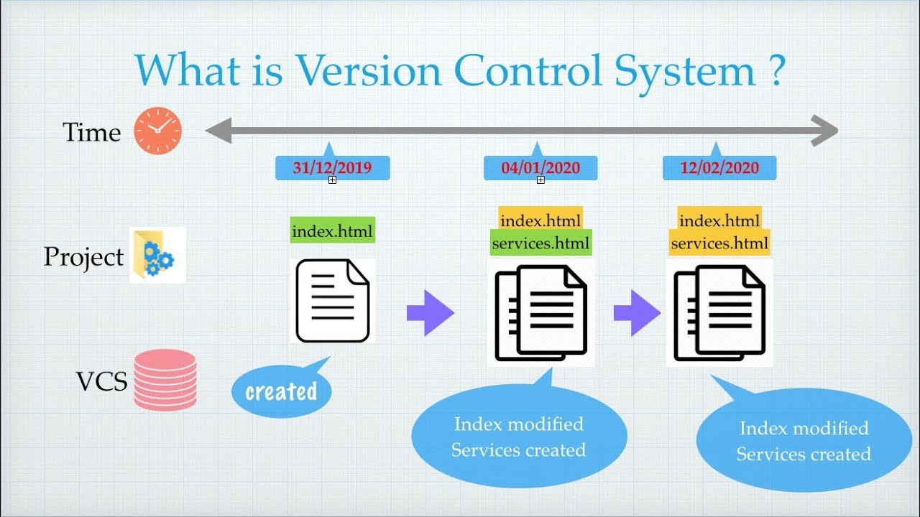
What is Version Control System?

Slide 4
What is Version Control ?
Version control is a system that records changes to a file or set of files over time so that you can recall specific versions later.
By using Version control in your project, you can easily find out:
What are the changes made
Which files are changed
When were the changes made
Who has made the changes

Slide 5
Why Use a Version Control System?
A Version Control System (VCS) gives you many super-powers that help you track changes and secure your source code such as,
Collaborating with big teams smoothly to develop code
Reverting the code to the bug-free version in case any minor changes in the new version introduces a bug.
Providing backup when the central server crashes
Rendering an option to time-travel your project and go to a specific version
Happy Learning ☺

Slide 6
Types of Version Control Systems
Local: It allows you to copy files into another directory and rename it (for example, project1.1). This method is error-prone and introduces redundancy.
Centralized: All version files are present in a single central server. For example, CVS, SVN and Perforce.
Distributed: All changes are available in the server as well as in local machines. For example Git and Mercurial.
Happy Learning ☺

Slide 7
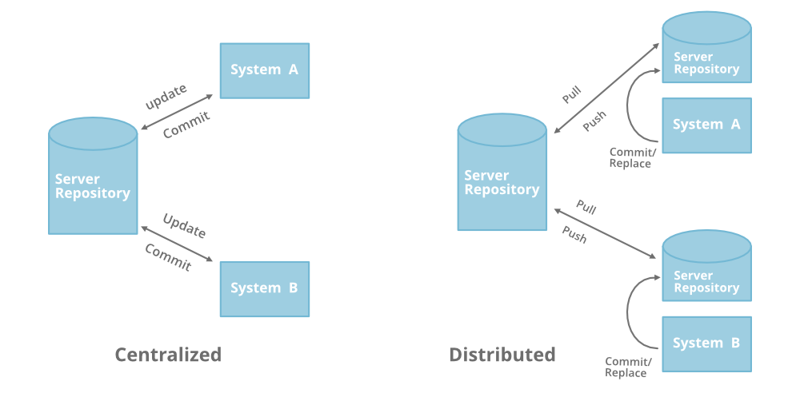
Centralized vs Distributed Version Control Systems
Centralized | Distributed
You can keep changes only in the server | You can keep changes locally (commit) as well.
Changes can be merged in the server(remote) alone | Changes can be merged locally as well as remotely
Work gets interrupted if the server is down. | The project is present with all the team members to work locally.
Git is the widely popular Distributed Version Control System which you will be learning in the session.
Are you ready?

Slide 8
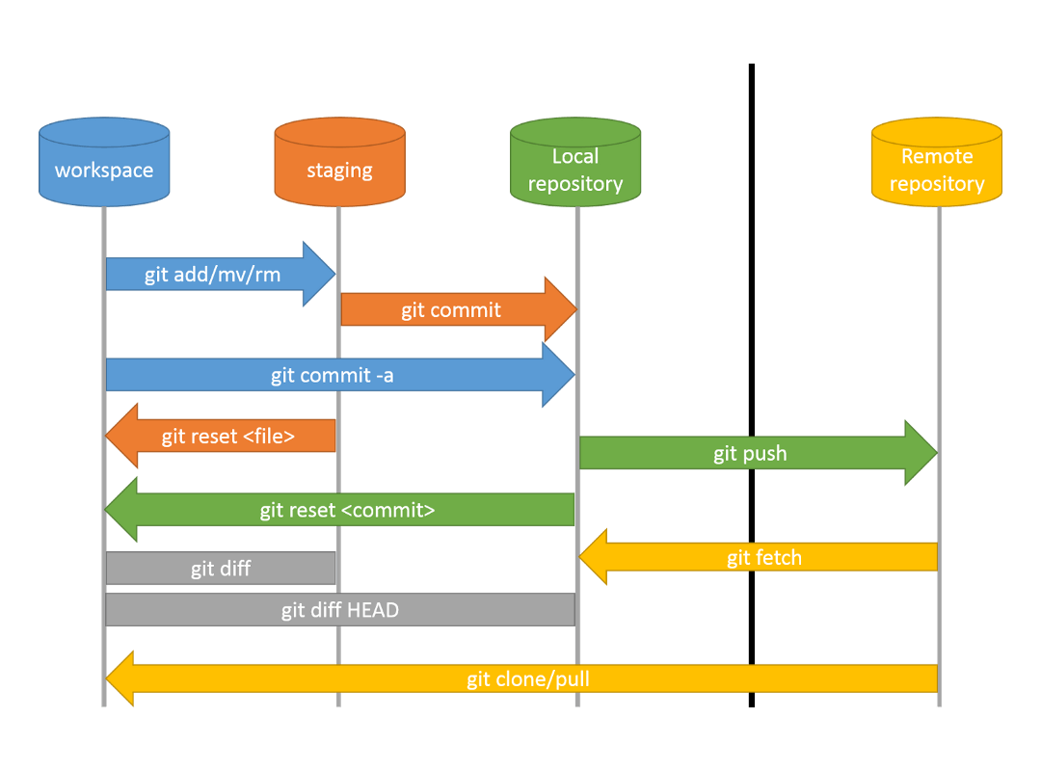
Cheat sheet
git clone : Get the complete project from remote to your local machine.
git pull origin <branch-name> : Get the new changes from remote branch to local branch.
git push origin <branch-name> : Send your local branch changes to the remote branch.
git remote add <name> <url> : Add a new remote repo link to your local repo.
git remote –v : list all the remote repo URLs linked to your local repo

Slide 9
Git Basics
Create new GitHub repo
Push code to this repo using git
Go over these git commands,
git add
git commit
git push
git difftool

Slide 10
How to Install Git?
For Windows
https://git-scm.com/download/win
For Mac
https://git-scm.com/download/mac
For Linux
Type the following commands from the Shell.
$ sudo apt-get update
$ sudo apt-get install git
After successful installation of Git, you can configure your user name and e-mail ID using the following commands,
$ git config --global user.name “Firstname Lastname”
$ git config --global user.email “myemail@gmail.com”

Slide 11
Git Terminologies
Before starting with the basics, let’s explore a few terminologies:
Git Repository: A directory with .git folder, where all the contents are tracked for changes.
Remote: It refers to a server where the project code is present. For example, GitHub and Gitlab.
Commit: It is similar to version. When you make changes in a file, you need to commit the changes in order to save and create its new version, which will create a unique commit hash. (like version number)
Origin: It is a variable where Git stores the URL of your remote repository. For example, origin => https://www.github.com/username/myrepo

Slide 12
Git Basic Commands
Before starting with the basics, let’s explore a few terminologies:
git init adds .git folder, and initializes the current folder to track its changes.
git status displays the current state of the staging area and the working directory, that is which files are added/removed/modified.
git diff shows the exact changes with line and column number
git add adds the changes to the staging area. If you have added a new file, this command starts tracking the file for modifications.
git commit will save all the changes with a unique hash number in the local repository
git push sends the changes to the remote repository (server)

Slide 13
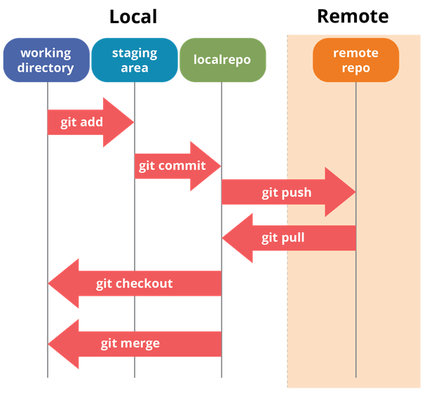
Stages in Git
The following are the three stages in the Git workflow:
working area you can edit files using your favorite editor/integrated Development Environment.
staging area you have made the changes and added the changes to Git. You can still make changes here. (From the analogy explained in the next card). It is like taking an item out of the box, where the box is the staging area. (git add)
local repository You have finalized the changes and committed them with a new hash and proper message. (git commit)
Remote Repository you can now push the changes to online platforms like Github or Gitlab from where others can collaborate.(git push)

Slide 14
Git Stages: Analogy
Git works in three stages known as The Three Trees: Working Area, Staging Area and Local Repository which means Git maintains three states of a file. To understand this better, let us take an analogy of a box.
Assume you are packing items in the house in different boxes and labeling them to identify it later.
Get a table and keep all the items than you want to pack underneath.( git init )
Now you might select specific kitchen items, dust them and club similar items (like spoons) together. (doing changes – working area)
Add the items that are ready to the box. (git add - Staged)
Seal the box and add a label – “Kitchen Items”. (git commit - Committed)
After git commit a unique hash is created and the changes are saved.

Slide 15
Git Basic Commands: add, commit, push
Git works in three stages known as The Three Trees: Working Area, Staging Area and Local Repository which means Git maintains three states of a file. To understand this better, let us take an analogy of a box.
Assume you are packing items in the house in different boxes and labeling them to identify it later.
Get a table and keep all the items than you want to pack underneath.( git init )
Now you might select specific kitchen items, dust them and club similar items (like spoons) together. (doing changes – working area)
Add the items that are ready to the box. (git add - Staged)
Seal the box and add a label – “Kitchen Items”. (git commit - Committed)
After git commit a unique hash is created and the changes are saved.

Slide 16
Git Ignore or Keep
If you do not want Git to any file/directory, you can add the file/directory to .gitignore file.
To track an empty directory, you need to add .gitkeep to that empty directory, as Git ignores them by default.

Slide 17
Git Basic Commands: add, commit, push
Create new github repository.
Push code to this repository using git
Go over these git commands,
git add
git commit
git log
git push
git difftool

Slide 18
Git History
Git provides the following commands, which allows you to read and review your repo’s history:
git log
git show
git diff
Before learning more about these tools, you must first understand the HEAD and Dot operators.

Slide 19
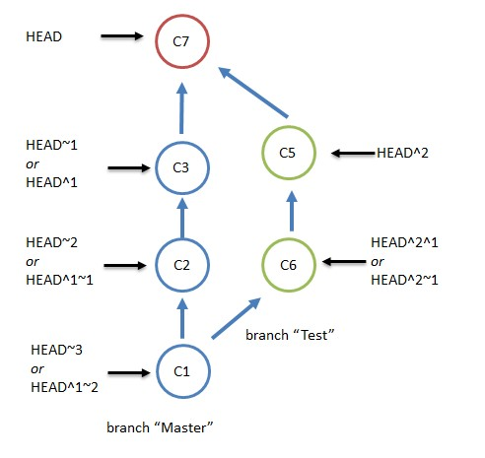
What is HEAD in Git?
HEAD is a reference variable that always points to the tip of your current branch, that is recent commit of your current branch.
HEAD can be used with the following symbols to refer to other commits:
Tilde symbol ( ~ ): used to point to the previous commits from base HEAD
Caret symbol ( ^ ): used to point to the immediate parent commit from the current referenced commit.
HEAD means the recent commit of current branch -> C7

Slide 20
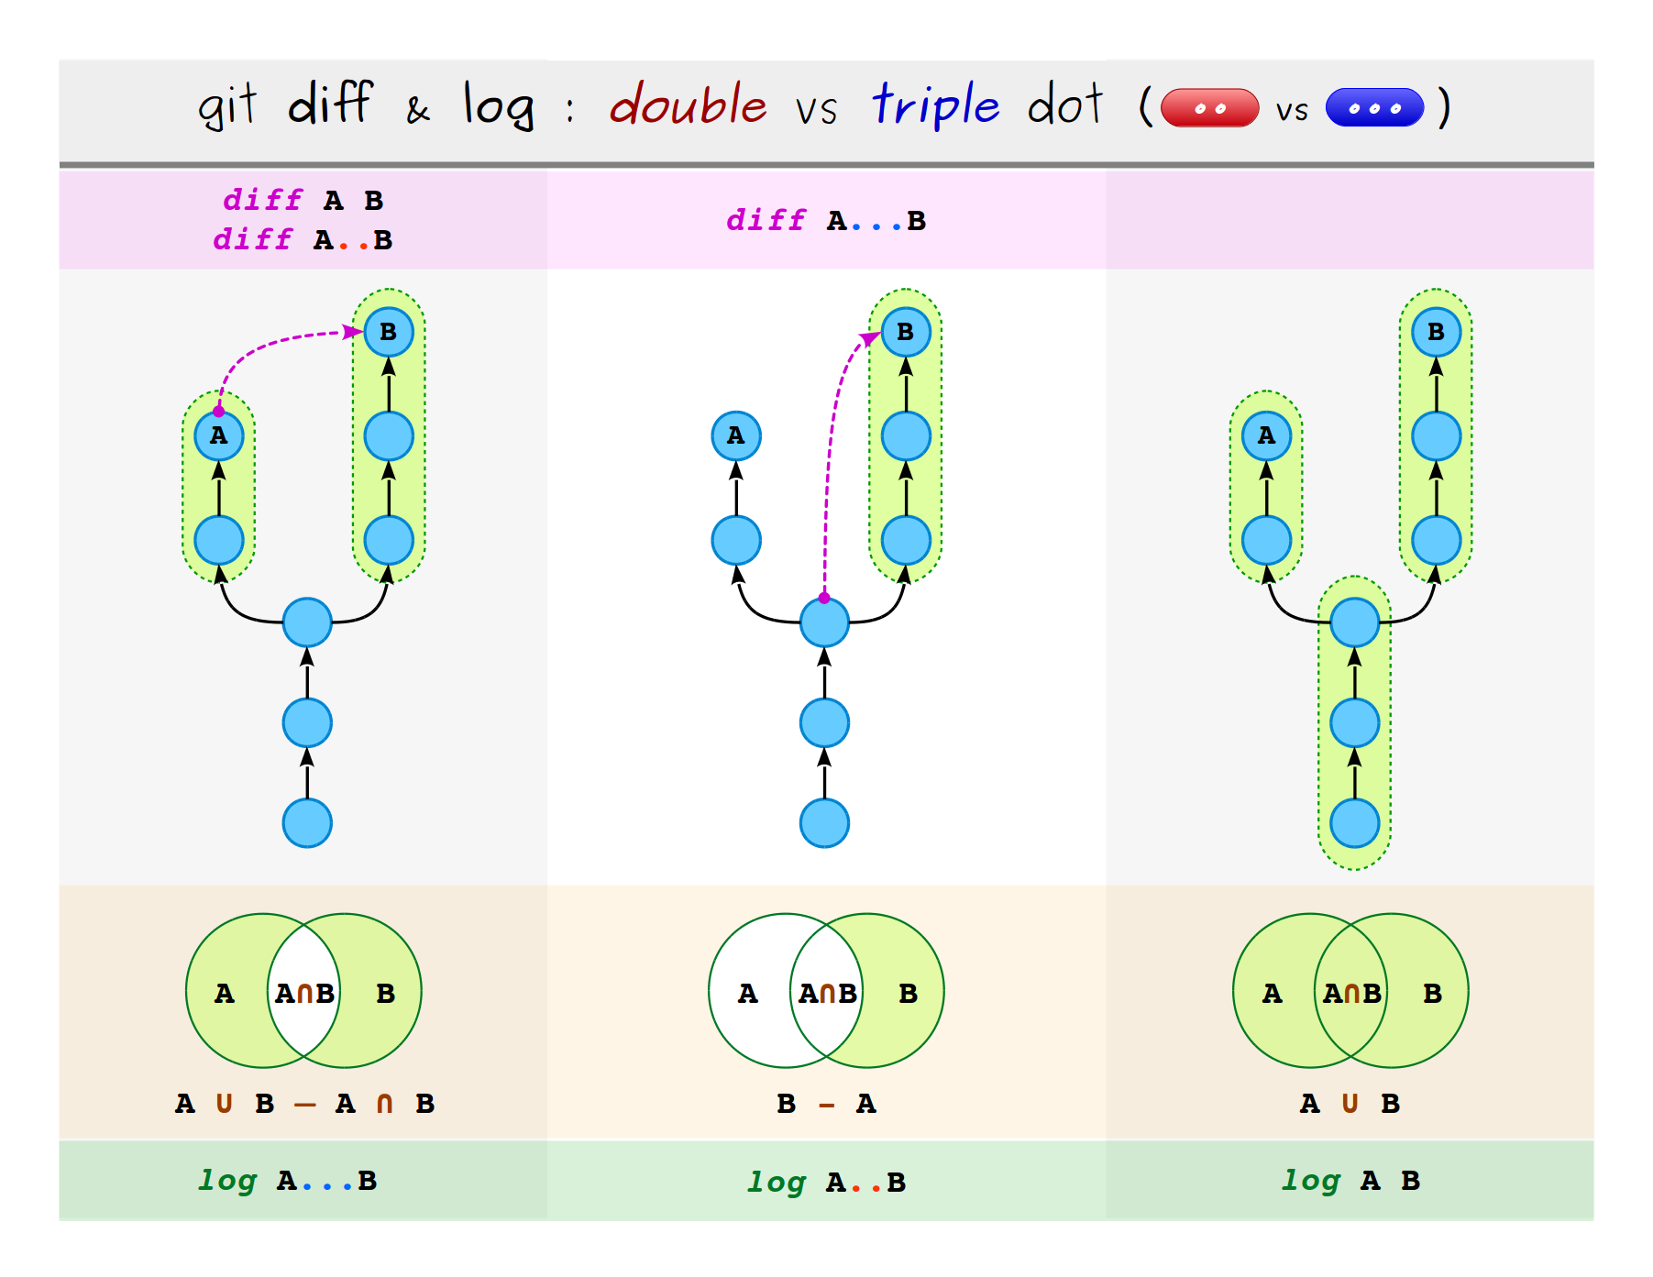
Dot Operators
Double Dot Operators
It is the default operator in git diff
git diff a..b or git diff a b command will display all the differences from A to C
Trible Dot Operators
It shows the differences between master and feature branch starting at the last common commit.
git diff A…B commands output would be the difference in B branch.

Slide 21
Git Log
Git log command shows the list of commits in the current branch. You can use it in the following ways:
git log -2 displays the history of last two commits
git log commit_id shows the history starting from commit_id
git log filename displays the list of commits for the file.
Flags
You can enhance the output of git log command using these optional flags:
git log --oneline : Fits the log output to a single line
git log --decorate : Adds a symbolic pointer to the output
git log --graph : Gives a graphical representation to the log output.

Slide 22
Collaborate Using Git
Local to Remote
To collaborate with other developers, you need to push your work to the remote repository, and vice-versa you need to pull others work from remote to contribute your work to the project.
In Git, remote is a repository on a server where all your team members can place the code to collaborate.

Slide 23
Remote URL Types
You can keep your project code in remote servers like GitHub, GitLab or on a self-hosted servers. Git sets a default name for your remote URL as origin
Remote URL can be one of the two types:
HTTPS URL like https://github.com/user/reps.git : you can clone/push using your username and password.
SSH URL, like git@github.com:user/repo.git : you need to configure SSH keys in Github/Gitlab account and local machine.

Slide 24
Git Clone
To get source code of an already existing project from remote repo (For example, GitHub) you can use
git clone <url> command
For example, git clone https://github.com/kannanfsd/accdevb1.git
This command downloads the complete project, all branches, commits and logs from the given remote URL (react repo here) to your local machine.

Slide 25
Git Pull
Your teammate hash pushed the changes to the project’s remote repo where you are also working. You can now pull the changes to your local machine using any one of the following commands.
git pull is the convenient shortcut key to fetch and merge the content
git pull <remote_name> <branch_name>
git fetch command downloads the remote content to your local repo, without changing your code changes.
git fetch <remote_name> <branch_name> fetches the content from that specific branch in remote to your current working area.
git merge command merges the fetched remote content to the local working tree.
git merge <remote_name>/<branch_name> merges the content to the specified branch.

Slide 26
Git Push
To keep your changes and work in remote repo, you need to push the branch using the command
git push <remote_name> <branch_name>
Git push takes two arguments, namely:
<remote_name>
<branch_name>
For example, git push origin master
origin will contain the remote URL
master is the branch that is pushed.

Slide 27
Working with Existing Projects
Mr. Max is new to the project. For a particular task, he created ten new files in his local machine. His technical lead said there is a common repo where all the team members place their code. He asked to Max to push his files to the same repo. What should Max do?
In such a scenario, you can connect your local repo with an existing remote repo using git remote add command.

Slide 28
Git Remote
The syntax to link your local repo with remote repo is
git remote add <remote_name> <remote_url>
It takes two arguments, namely:
<remote_name>, let us take default name origin
<remote_url>, let us take https://github.com/kannanfsd/repo.git
For example: git remote add origin https://github.com/kannanfsd/repo.git

Slide 29
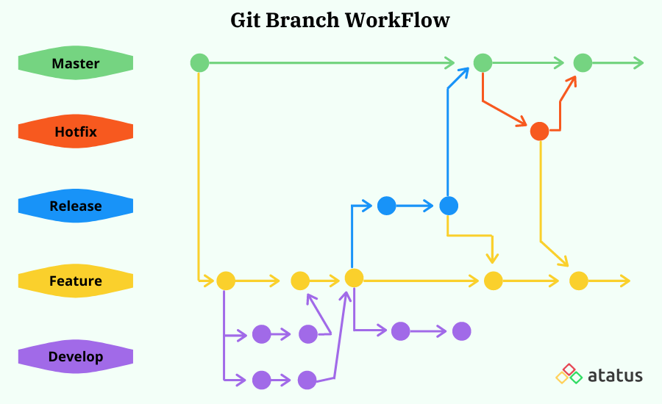
Branches
A branch is a copy of your complete project, where you can add new changes and develop new features. Technically, it is a collection of commits.
When you create a new Git project, it has a branch called master by default.

Slide 30
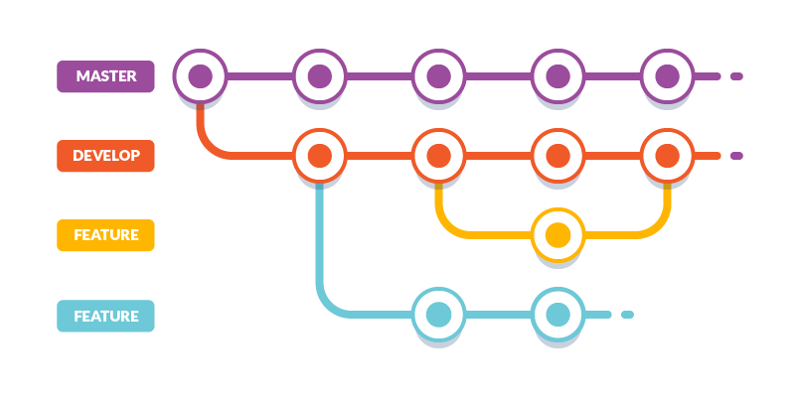
How to Build Features?
To build new features without affecting the current working code, you need to:
Create new branch from the master git branch <branchname>. Here you will create code for the new feature.
merge the feature branch with the master (or other branch where you want it to be). You can merge two branches locally or in remote.

Slide 31
Branch Operations
You can do the following with branch:
Creating new branch: git checkout –b <branch-name>
Pushing branch from local to remote repo: git push origin <branch-name>
Renaming branch:
Renaming local branch: git branch –m old-name new-name
Renaming remote branch: git push origin :old-name new-name
Deleting branch
Deleting local branch: git branch –d <branch-name>
Deleting remote branch: git push origin –d <branch-name>

Slide 32
New branches for New Features
In a project, two developers need to build sign-in and sign-up pages at the same time. How can they do that without affecting the existing application?
They can create new branches for each new feature, such as signin and signup branches and work on the features parallelly.

Slide 33
Building New Feature: signin
For a new feature to be built:
Create a new branch from the master branch: git checkout –b signin
Add your new code in the new feature branch: git add <filename>
Commit your changes once done: git commit –m “add signin page”
Push your changes to the remote: git push origin signin

Slide 34
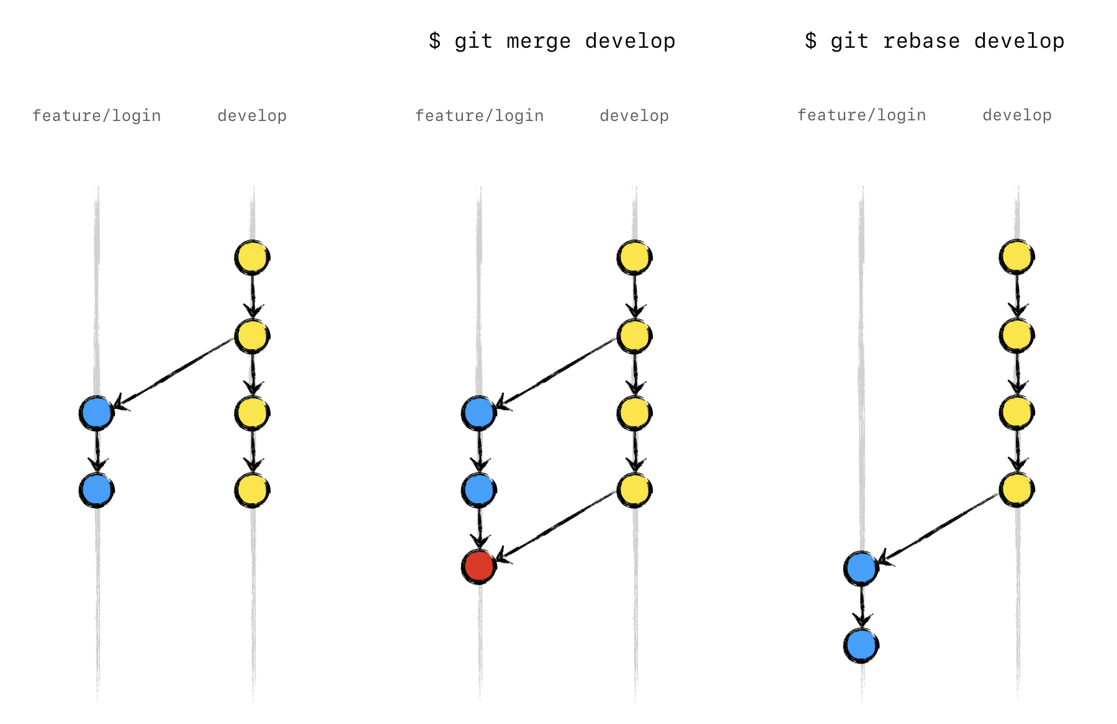
Merging
Integrating Changes
Once you have developed your feature in a separate branch, you need to integrate the feature and master branch. You can do that using one of the following two commands:
merge
rebase

Slide 35
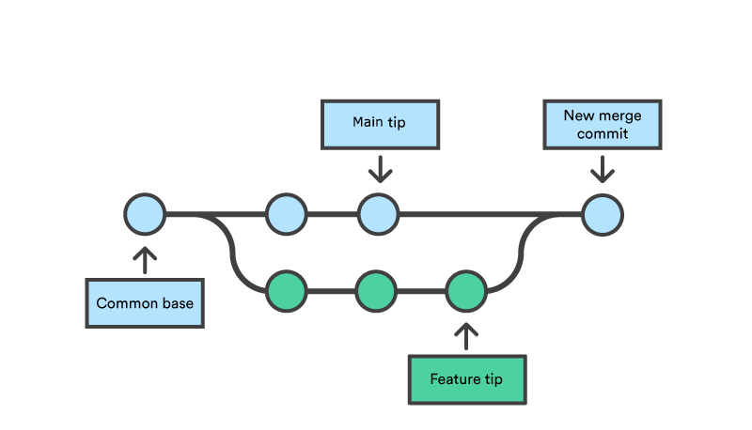
What is Git Merge?
Merge is an operation to integrate changes from one branch to another branch by adding a new commit

Slide 36
Merging Feature Branch: sign-in to master
You can merge with sign-in branch with the master in two ways:
In your local and push master: git merge master sign-in && git push origin master
In remote server: you need to create a new pull request (or merge request) from sign-in branch to master branch in GitHub portal.

Slide 37
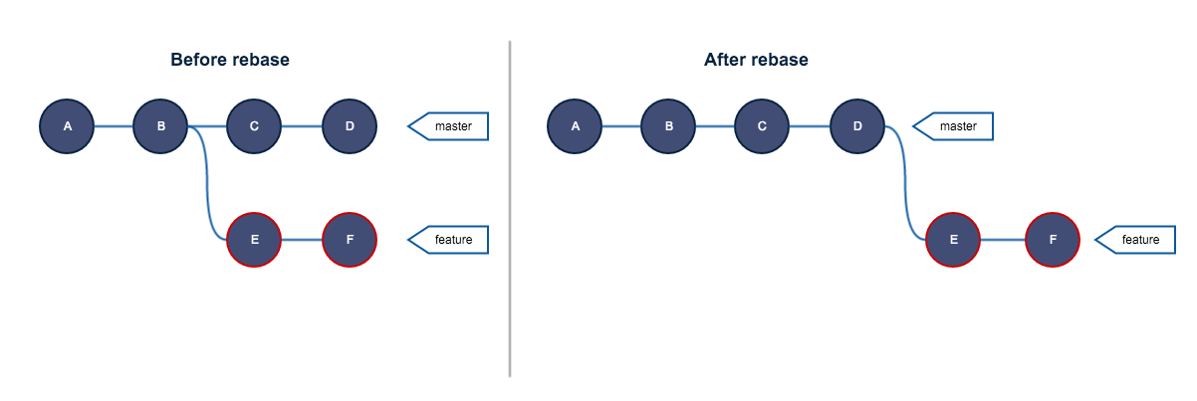
What is Git Rebase
Rebase is an operation to integrate changes from one branch to another. It is an alternative to the merge command.
If you are re-bashing feature branch with master, the command will remove the original commits on feature, bring all the commits from master to feature and add the original commits on top of it.
This changes the commit hashes and re-writes the history.
This gives linear flow of development when you look at the history of repo.

Slide 38
Merge vs Rebase
While merge and rebase are both used to integrate changes of two branches, let us see how they differ and which one you can use.
 | Merge | Rebase
What it does? | Creates new commit while integrating changes from one branch to another. | Does not create any new commit while integrating changes from one branch to another.
Safe or not? | It is safe in nature, as it does not re-write the history of feature branch. | It is destructive in nature, if you rebase feature branch with latest changes in master, your feature branch commit hashes changes.
When to use? | When your feature branch is in remote and someone else is creating new branch on top of your feature branch. Use git merge to get the changes from master to feature. | When your feature branch is local and changing history will not affect others. Use git rebase to get new changes from master to your feature branch.

Slide 39
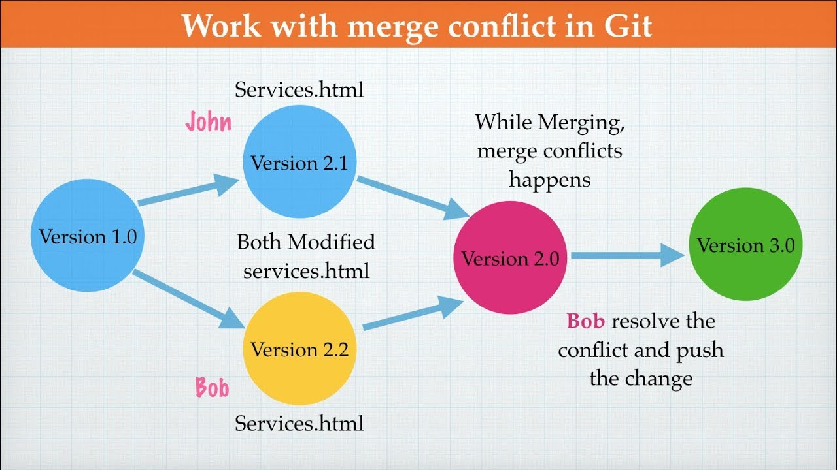
Conflicts
Suppose you have planned to go for a movie with your family at 8PM tomorrow. And at the same time, your best friend has asked you to join for dinner.
What will you do? Confused?
Well, this is what happens to Git, conflict arises when two developers change the same line of code. Git fails to understand which line to keep and which one to delete. So it asks you to resolve the conflict.

Slide 40
Commands that can cause conflicts
git merge
git rebase
git cherry-pick
git stash pop
git pull

Slide 41
Managing Changes
When you make a mistake in word, what do you do ? CTRL + Z, right?
You cannot undo your mistakes in Git as you do in word, but don’t worry, Git gives you the following.
Set of commands to undo your changes:
amend
checkout
reset
revert
Set of commands to undo/remove your files:
rm
clean

Slide 42
Git Amend
git commit --amend command is used to fix your previous commit where you do not want to add a new commit. You can:
Correct your typos in commit messages
Add small changes in the file that you missed adding in the last commit

Slide 43
Git Checkout
Checkout is used to switch. You can switch between branches, commits and files. Here you will learn how to use this command to undo changes.
You can apply checkout command on:
Working file
Commit

Slide 44
Checkout Files
If this is what you feel, you can use checkout command to discard all your changes from your working area and switch to the last committed version of your file. This command will help you restart your work as if nothing happened.
Example git checkout filename
Note: This command will only discard the changes in the working area. If you have already staged the changes you need to use reset command first..

Slide 45
Checkout Commits
While debugging the application, if this thought crossed your mind, then you can use git checkout command to switch to a specific commit.
For example: git checkout commitSHA
commitSHA is the commit has to identify it uniquely. You can find this using git log
This command creates a detached head, meaning, this will give you a temporary branch to work and debug.
Avoid creating any new commits here, as this is a temporary branch.

Slide 46
Git Reset
Reset, as the name says, is used to reset your work to a specific point in time (a commit). It is a powerful and versatile command, using which you can even undo the changes that you have already committed.
Imagine your git history as a timeline, then you can quickly jump to a specific time in the past and reset your work as if nothing happened.
To apply reset command on:
staged files
commits

Slide 47
Reset – Staged files
If you have staged your changes and forgot to add something, you can reset the file, so the file is moved from staging to working area where you can make the required changes.
For example: git reset filename

Slide 48
Reset – Commit Files
You can move to the previous commit where the app is working fine. Did you wonder what will happen to the changes in those two commits that you are skipping? You can use one of the following three flags, which decides in which stage the changes should move:
--soft : this moves your commit changes into staging area and does not affect your current working area.
--hard : this deletes all the commit changes. Be cautious with this flag. You might lose your changes as this flag resets both staging area and working directory to match the <commit>.
--mixed : this is the default operating mode, where your commit changes are moved to working area.
For example, git reset --mixed <commitSHA> , by default moving all the changes to the working directory.

Slide 49
Git Revert
You tracked a bug in your project which was due to a rogue commit.
git revert is another command to undo changes from an old commit, similar to reset. However, git revert inverses the changes from that old commit and creates a new revert commit, instead of deleting the old commit.
This helps prevent Git from losing history.
For example,
git revert commitSHA
git revert –n commitSHA

Slide 50
Revert vs. Reset Commits
While both reset and revert can undo your commit changes, the following are a few differences.
Revert | Reset
Does not delete commits and preserves history. | Deletes commit and changes history.
If other developers are using your branch to build new features, prefer revert to undo changes on that branch as it might prevent any conflicts. | Prefer reset if the branch is only in local

Slide 51
Delete Files
Just like changes (in a file), you might also want to undo/remove files. Depending on its status, whether Git is tracking the file or not, you can use the following commands to remove them:
git rm
git clean

Slide 52
Git rm
git rm is used to delete any tracked file from your repository. Files from both the staging area and the working directory can be removed using the same.
These changes will not persist until a new commit is added, which in turn creates a new commit history.
You can get back your deleted files using git reset and git checkout

Slide 53
Restore Deleted Files
How to restore a deleted file?
First, find the commit ID where the file was deleted: git rev-list –n 1 HEAD -- filename
Then checkout to that commit ID to get back the file git checkout deletingCommitId^ -- filename

Slide 54
Git clean
git clean command undoes files from your repo. However it stands unique from other undo operations like checkout, reset and revert as it primarily focuses on untracked files.
git clean is undoable
Git clean makes hard file deletion possible, similar to the Unix rm command.
It is good to execute git clean –n command to perform a dry run, which helps to know the list of files to be removed.

Slide 55
Golden Rules of Git
Create a new repository for every new project
Create a new branch for every new feature.
Let branches be temporary, that is delete the merged branch.
Write a good descriptive commit message, where:
The first line should not be more than 75 characters
Fix, feature or update is present at the start of your commit message
Use Pull Request (PR) to merge your code with master.

Slide 56
Course Summary
In this session, we have learned about Git. We have understood the following conceps,
Get a table and keep all the items than you want to pack underneath.( git init )
Now you might select specific kitchen items, dust them and club similar items (like spoons) together. (doing changes – working area)
Add the items that are ready to the box. (git add - Staged)
Seal the box and add a label – “Kitchen Items”. (git commit - Committed)
After git commit a unique hash is created and the changes are saved.

Slide 57
Creating SSH Keys
Generate new SSH key, ssh-keygen –t rsa –b 4029 –C “youremail@gmail.com”
Assume you are packing items in the house in different boxes and labeling them to identify it later.
Get a table and keep all the items than you want to pack underneath.( git init )
Now you might select specific kitchen items, dust them and club similar items (like spoons) together. (doing changes – working area)
Add the items that are ready to the box. (git add - Staged)
Seal the box and add a label – “Kitchen Items”. (git commit - Committed)
After git commit a unique hash is created and the changes are saved.

Slide 58
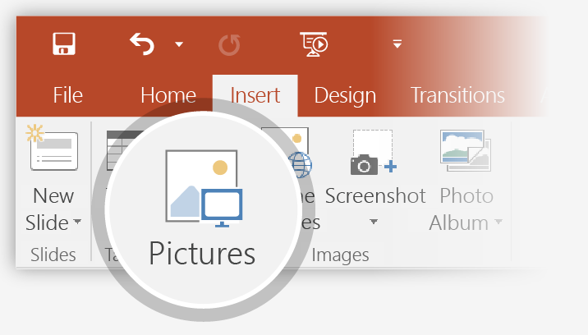
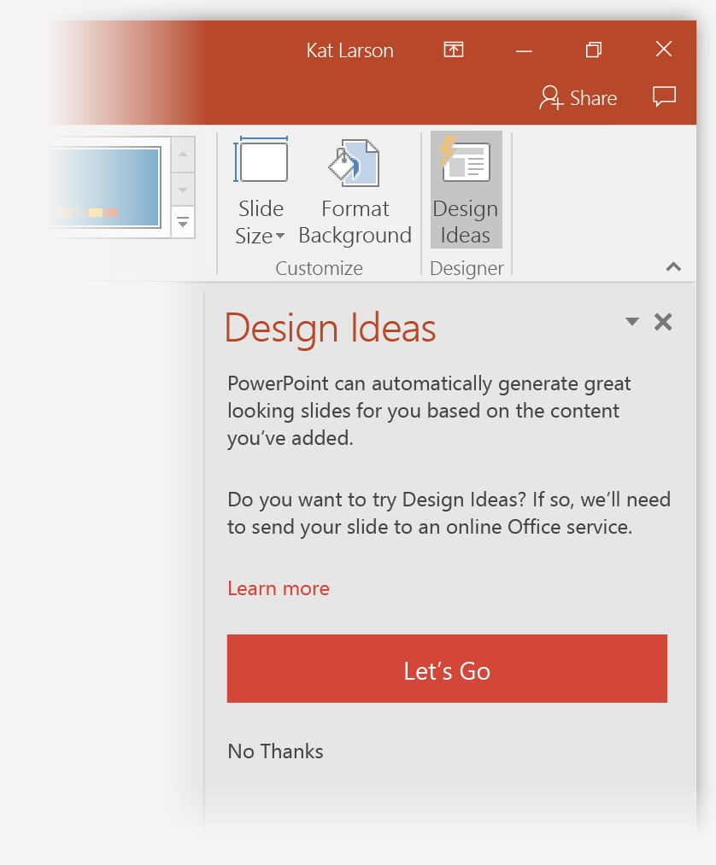
How to use PowerPoint Designer
How it works:
1
Start a new presentation by going to File > New > Blank Presentation.
2
On the very first slide, add a picture: Go to Insert > Pictures or Insert > Online Pictures and choose the picture. Hint: You need to be online when you add the picture.
3
When PowerPoint asks your permission to get design ideas, select Let's Go.
4
Choose a design you like from the Design Ideas task pane.

Slide 59

Morph
Morph makes smooth animations and object movements in your presentation. You use two similar slides to perform the animation, but it looks to your audience like the action happens on one slide.
Play the video on the right to see a quick example.
Morph is a subscription-only feature. If you have an Office 365 subscription, you can try it yourself with the steps on the next slide.

Slide 60
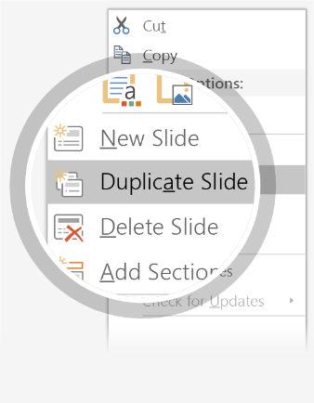
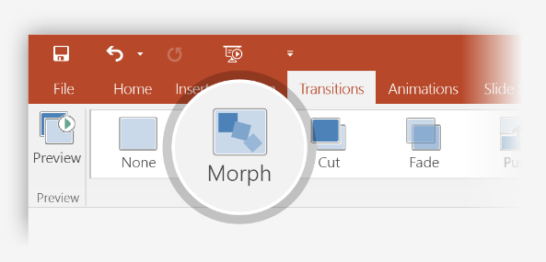

Setting up Morph
Try it yourself with these two simple “planets”:
1
Duplicate this slide: Right-click the slide thumbnail and select Duplicate Slide.
2
In the second of these two identical slides, change the shapes on the right in some way (move, resize, change color), then go to Transitions > Morph.
3
Return to the first of the two slides and press Slide Show button and then select Play to see your circle morph!
Hint: Effect Options gives you even more options for Morph.

Slide 61
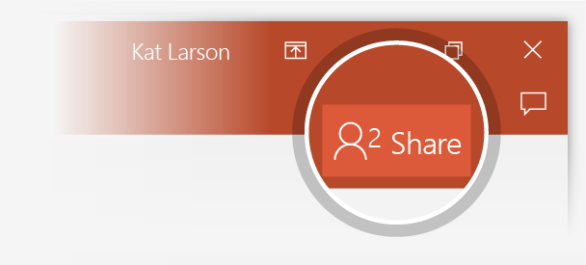
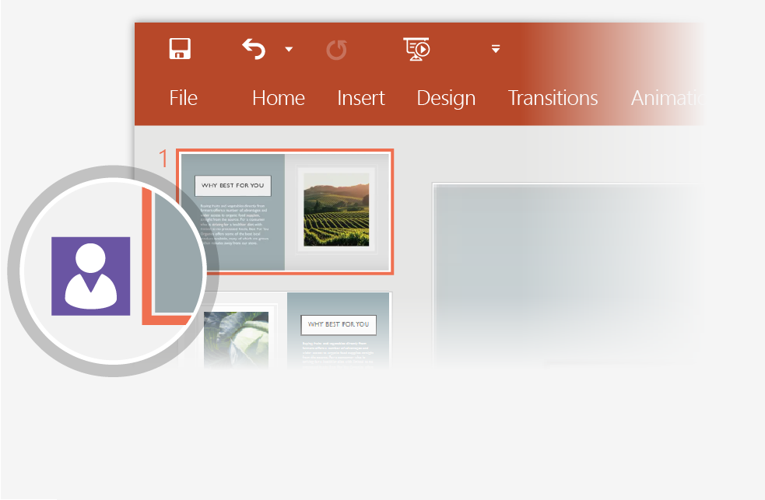
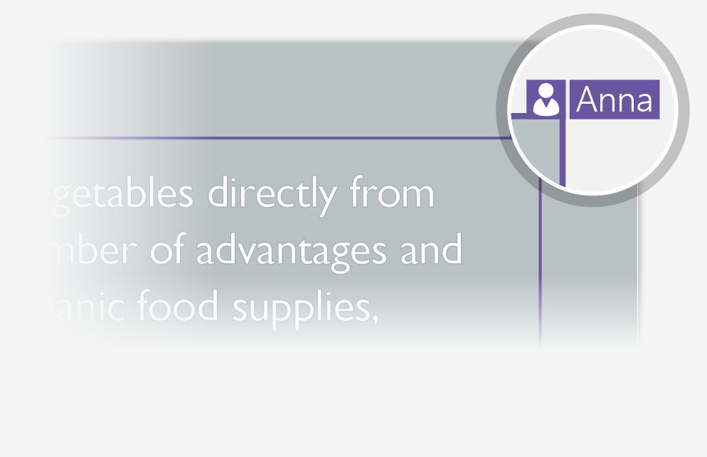
Working together in real time
When you share your presentation with others, you’ll see them working with you at the same time. How it works:
1
Select Share from above the ribbon, or by using short-key Alt-ZS, to invite people to work with you (You can save to the cloud at this point.)
2
When other people are in the presentation, a marker shows who is on which slide…
3
…and the part of the slide they're editing.

Slide 62


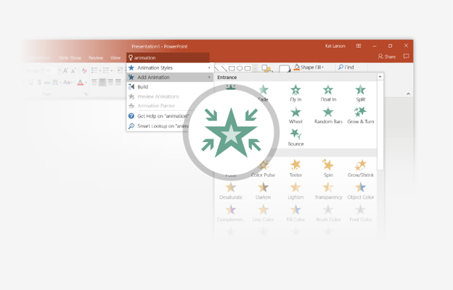
You’re an expert with Tell Me
The Tell Me box finds the right command when you need it, so you can save time and focus on your work. Try it:
SELECT ME
1
Select the Robot picture on the right.
2
Type animation in the Tell Me box, and then choose Add Animation.
3
Choose an animation effect, like Zoom, and watch what happens.

Slide 63
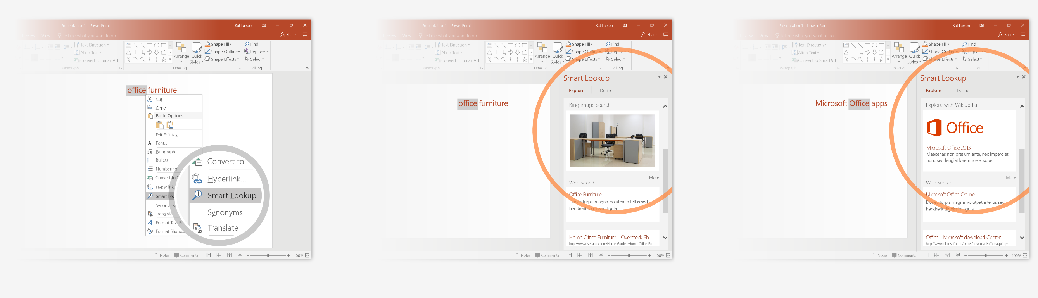
Explore without leaving your slides
Smart Lookup brings research directly in to PowerPoint. Try it:
1
Right-click in the word office in the following phrase: office furniture
2
Choose Smart Lookup, and notice that results are contextual for that phrase, not Microsoft Office apps.
3
Just for fun, try Smart Lookup again by right-clicking in the word Office in Step 2.

Slide 64
Maven
Maven is a very popular build automation tool used for Java projects. In this session, you will learn:
Core concepts of Maven
Significance of POM file
Build lifecycle of Maven
Phases of Maven
Goals of Maven
Usage of various Maven commands
Integration of Maven with Jenkins.

Slide 65
What is Maven?
Maven is a comprehensive build management tool that helps developers in performing the following tasks related to any project.
Compiling the source code
Running the test
Packaging the code into jar files.
Performing related activities such as,
Create websites -> upload build result -> Generate reports
Deploying the final product

Slide 66
Why Maven?
Often while working on a Java application, you might be handling numerous jar files.
You will have to handle proper dependency, version inclusions, building, publishing as well as deploying the app.
One of the efficient and hassle-free ways to deal with these activities is to use a automated build tool like Maven.

Slide 67
Setup Maven environment
Verify Maven Installation using,
$ mvn –version or $mvn -v

Slide 68
Maven Core Concepts
Maven works around the following core concepts:
Project Object Model (POM) is the XML representation of the project where all the dependencies and configuration details are stored. POM plays a major role in ensuring that all the project resource references are maintained.
Build Life Cycles, Phases, Goals – Maven build process is composed of many build life cycles. Each life cycle has one or more phases. Each phase has one or many associated goals.

Slide 69
Maven Core Concepts (continued)
Dependencies and Repositories – Dependencies are external JAR files required for the project to work. Maven downloads these dependencies into the local, central or remote repository.
Build Plugin – Adding plugins to the POM file allows us to add new custom actions to be done during the build process.
Build Profile – Projects can be built differently by using different build profiles.

Slide 70
POM File
Each project has a corresponding POM file that is located in the root directory
Whenever a goal (a specific build task) has to be executed, Maven looks for the configuration details in POM
Project details can be represented in the form of XML file called pom.xml
It is the fundamental unit that contains information about the project.
It holds all the resources required for a build such as source code location, test source, dependency details such as external or internal dependency etc.

Slide 71
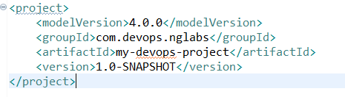
Unique Identifier for POM file
pom.xml takes minimal coordinate attributes as
Inputs for the project as groupId : artifactId : version (alias GAV)
POM stores the information such as the location of the source code and records any external dependencies. It describes what needs to be built as part of the project.
Sample POM file

Slide 72
archetype:generate
Archetype
Group ID
Artifact ID
Version
package

Slide 73
Dependency Management
One of the key benefits of using Maven is its effective dependency management mechanism.
As the project complexity grows, the number of jar files and other external APIs that might be needed for the project to consume/interact might grow. This might lead to difficulties in managing such dependencies along with appropriate versions.
With Maven, all dependencies of your project are maintained in a single pom.xml file. Maven takes care of downloading these dependencies into the local repositories and makes them available for the project.

Slide 74
Maven Repositories
All the dependencies are held and maintained in a repository in Maven. These repositories are the directories of packaged jar files.
Whenever Maven searches for dependency addition, it looks at local repository followed by central repository then the remote repository.
A local repository refers to the repository on a developer’s computer.
A central repository is the one that Maven community provides
A remote repository could be one on the web server from where the dependencies can be downloaded.

Slide 75
Maven Repositories
All the dependencies are held and maintained in a repository in Maven. These repositories are the directories of packaged jar files.
Whenever Maven searches for dependency addition, it looks at local repository followed by central repository then the remote repository.
A local repository refers to the repository on a developer’s computer.
A central repository is the one that Maven community provides
A remote repository could be one on the web server from where the dependencies can be downloaded.

Slide 76
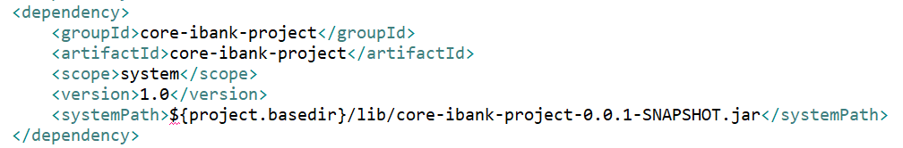
Get a New Dependencies
There are many repositories that hold some of the commonly used Maven dependencies. https://mvnrepository.com/ is the recommended site for getting the needed ones.
Let us search for spring-core maven dependency in https://mvnrepository.com/ . You could click on the needed version to get the dependency information as shown below. The same can be copied to the dependencies element in pom.xml
The dependency will be downloaded and kept at MAVEN_REPOSITORY_ROOT=.m2/repository/ in Linux

Slide 77
Dependency Ranges
Till now, we were defining the version for dependency uniquely
Let us see how we can specify dependency version for
As greater than range
In between range

Slide 78
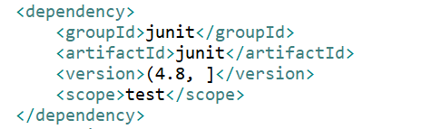
Dependency Ranges
If user depends on any version of Junit, which is higher than 4.8
Dependency range for Junit will be specified as Junit > 4.8
You can define it using exclusive quantifies boundary denoted as (, ]

Slide 79
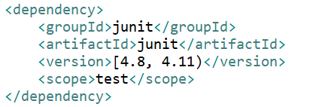
Dependency version in between range
If user depends on any version of Junit, which is greater than or equal to 4.8 but less than 4.11
Dependency range for Junit will be specified as Junit 4.8 to Junit 4.11
You can define it using exclusive quantifies boundary denoted as [, )

